Slide 1
CERTIFIED DATA SCIENTIST
PEOPLE INFORMATION TECHNOLOGY PROGRAM
Lecture 04
Muhammad Nabeel Ibrahim Khan
NED University of Engineering and Technology

Slide 2
Agenda
Anaconda Introduction
Python Fundamentals

Slide 3

Anaconda Introduction
What it is?
What it provide?
Why you’d use it?

Slide 4
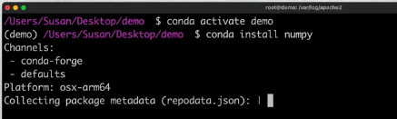
CONDA Utility
Software that includes pyhton and a lot of tools that wporks with python
Example of such tools are:
Command Line Python Package Manager (CONDA)

Slide 5
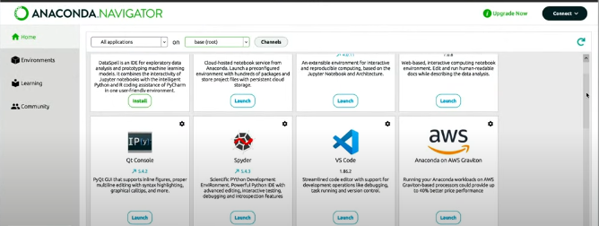
Navigator
Desktop Based application listing all the tools and other useful features such as environments supported by Anaconda

Slide 6
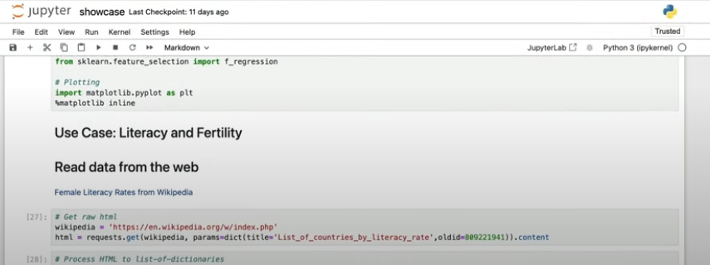
Jupyter Notebook
The Jupyter Notebook is a web-based interactive computing platform.
The notebook combines live code, equations, narrative text and visualization

Slide 7
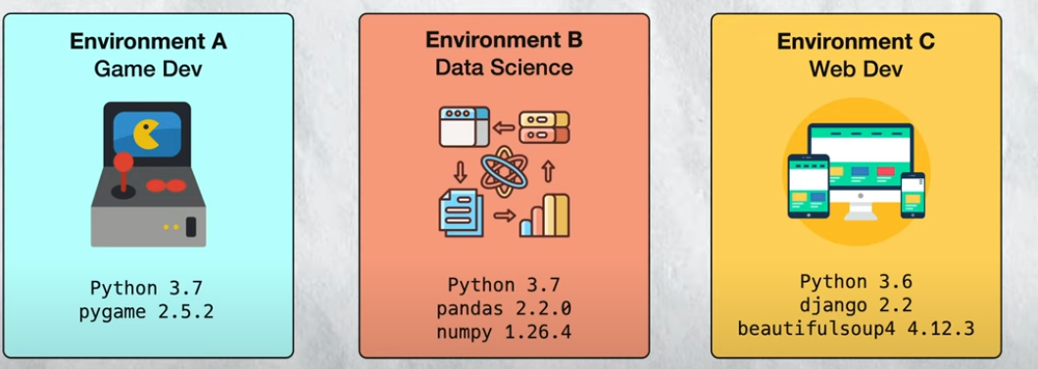
Environments

Slide 8
Alternatives
To replace Conda utility we may use Python Package Index (PIP).
For Anaconda Environments, we may use virtualenv.
For Jupyter Notebook, we may use Visual Studio Code.

